Slide 1
Boa - Introduction
- Level 0 -

Slide 2
Overview
What is Boa?
Best uses for boa
Boa: The Basics
Syntax
Examples
Sources / Suggested Resources

Slide 3
What is Boa?
Domain-specific language (DSL)
Mines software repositories
Software as a Service (SaaS)
Has its own compiler
Ex. Query Language for Git Repositories

Slide 4
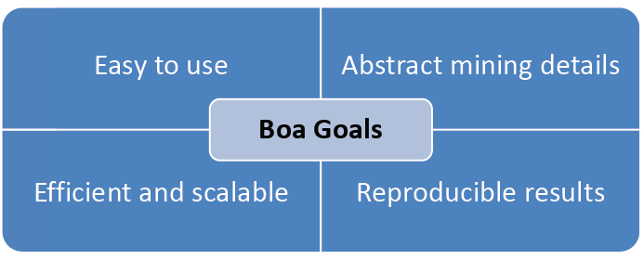
But why Boa?
Notes:
Simple to use
Significantly less code
Scalability
Running on hadoop
Large amounts of data
Reproducibility (same input, same output)

Slide 5
Boa: The Basics
How to use Boa?
Login to http://boa.cs.iastate.edu/boa/ .
Select Run Example.
Select an existing example or create your own query.
Magic!

Slide 6
Syntax of Boa language
Declaring a variable: name:Type = value;
Input variable
p:Project = input;
(this is used at the start of all boa programs)
Output:
Note that Boa does not have explicit print statement; it prints out every output variable after execution.
counts: output aggregator(param)[indices] of T [weight];
Typically assigned values later on in the code.
“output” MUST be included in variable declaration. There are multiple output aggregators.
“<<” operator:
Takes value and add it to the aggregator (aka. Adds value to variable)

Slide 7
Example 1

Slide 8
Example 1

Slide 9
Example 2

Slide 10
Example 2

Slide 11
Example 3

Slide 12
Example 3

Slide 13
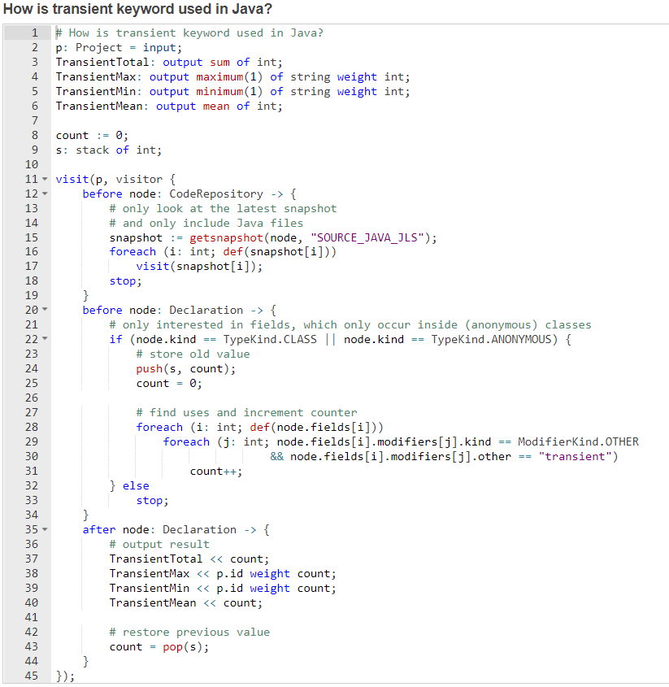
Complex Example
Normally queries aren’t this long!
We will work up to this level.

Slide 14
Sources / Suggested Resources
ISU CS Website: http://boa.cs.iastate.edu/docs/index.php
UCLA Website: http://web.cs.ucla.edu/~shyoo1st/boa/

