Slide 1
Lightning Talk
Team sdmay20-43
Adrian Hamill
Megan Miller
Benjamin Carland
Yi-Hsien Tan
Diego Realpe

Slide 2
Problem
Integrate boa with GitLab .
Analyze data mined from GitLab using boa.
Generate reports using R.
Mining Ultra-Large-Scale Software Repositories

Slide 3
Purpose
Client: Professor Simanta Mitra
Give insight into the analytics of his student’s projects in ComS/SE309.
Expand possible uses of boa for different organizations to mine data and analyze projects

Slide 4
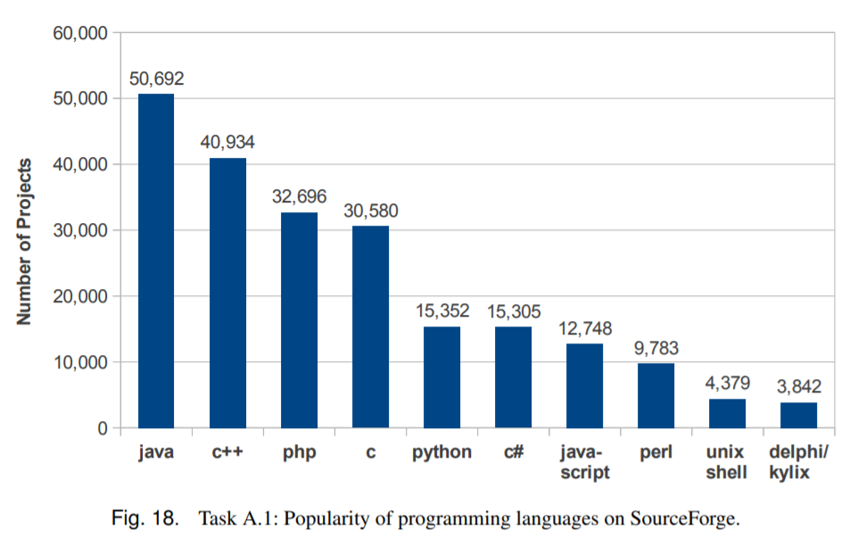
Overview (what we do)
Understand how data is stored in GitLab v.s. GitHub
Find a way to pull data from GitLab (boa)
Fetch the data and display in easy to understand format (R)

Slide 5
Get/About Data
General approach has been broken down into two pieces
Data Parsing from Gitlab:
Work with the Client’s code repository
Research how to obtain metrics from it
Using Boa to analyze mined data:
Combine R and Boa to evaluate code quality
Help on 309 pedagogy

Slide 6
Finished Product
A Gitlab integration of BOA
Queries for analyzing code Quality
R will handle the query results
This can be used for educational purposes
Commercial Applications?

