Slide 1
Lightning Talk
Team sdmay20-43
Adrian Hamill
Megan Miller
Benjamin Carland
Yi-Hsien Tan
Diego Realpe
Notes:
Hello, we are Team sdmay20-43 and our project is creating a framework to implement Boa on Gitlab. This is our lightning talk about our project plan.

Slide 2
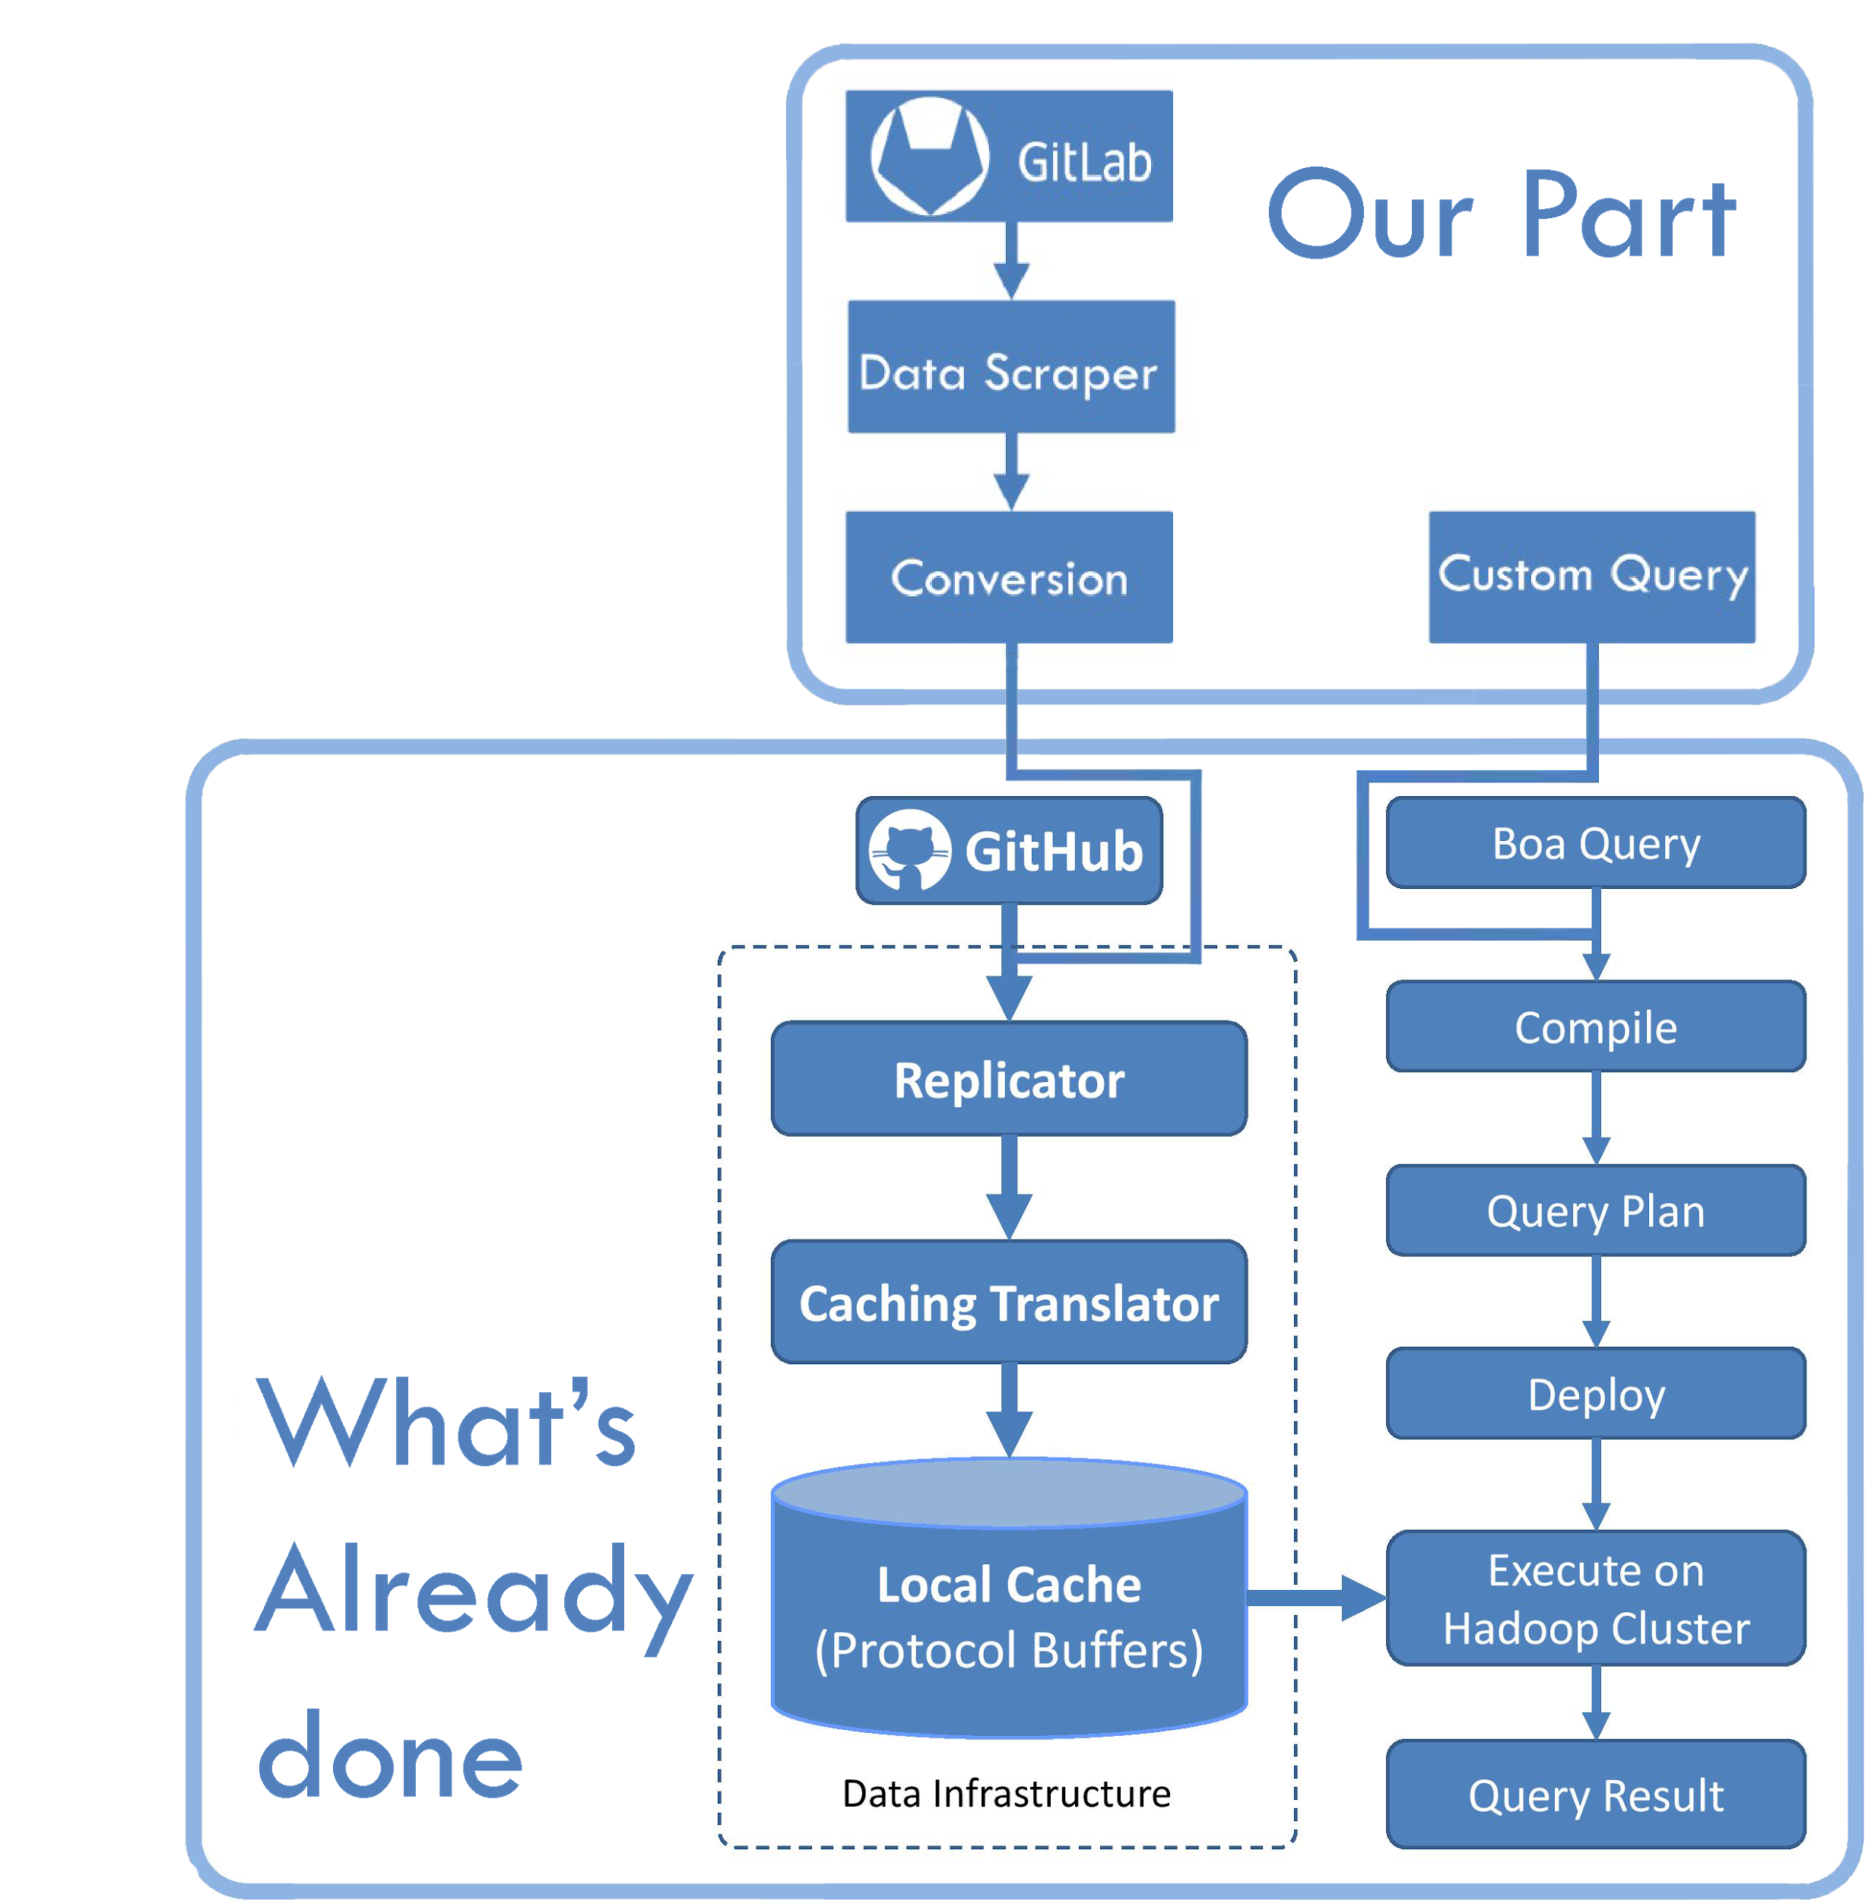
High Level Overview
Left Path
Download Repositories
Create json files with Metadata
Convert into a Custom object used by boa researchers
Right Path
Create Queries for repository data
Create Visuals out of Query Result
Notes:
For a high level overview of the project, refer to the image on the right-hand side of the slide. The bottom section shows the work done prior by the research team and what our team will be working with, and on top is what our team’s contribution will be.
LEFT PATH
Beginning at the top of the left path, we will first start by downloading the desired repositories from the gitlab database. Then we’ll write a query that will scrape through the projects collecting all the metadata that we need (including commit dates, number of commits made, languages used, file types, etc.). Once this data is gathered together, we’ll convert it into custom objects, created previously by the research team. After that, the objects are subjected to the already established process of being uploaded to the cache and executed on the hadoop cluster
RIGHT PATH
Overall, not much needs to be added to this process. Our job will consist primarily of writing our own custom BOA queries for the gitlab objects. After the gitlab repositories have gone through all the steps in the left path, we will run our custom queries on the data to create graphs using R (which we will talk more about in a later slide).

Slide 3
Repository Data
Analytics data
Traffic Data
Timeline of Pushes
Size of Pushes
Ect.
Source-code data
For code quality analysis
Notes:
The repository data will be important here because the current implementation of gitlab doesn’t extract metadata in the same way as Github does. Choosing the right data to focus on will make the grading of the student repositories more efficient and the allow the queries on boa to more complex. So our project will involve extracting the repository data ourselves in the proper format. In terms of actual data Traffic data encompases numbers relating to repository access. This type of data will allow the graders to view the total contributions and activity on the repository. This will be useful for the graders to see the total effort of the team contributed. User contributions over a timeline will show how the group as individuals are committing their changes. The data encompassing the size of pushes will help to determine the quality of the changes at a glance. Any other gitlab analytics data that we can find that would help for grading will be implemented into the repository data. The source-code should be a matter of simple reformatting since it is the one aspect that is displayed in a file format.

Slide 4
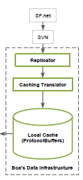
Custom Object Conversion
The BOA analysis can’t happen on raw data.
Based on research from ISU’s BOA labs, code needs to pass a conversion.
Standard object to run queries against
Object is in Hadoop Sequencefile Format
Contain messages with relevant data
Can add custom modifications to the object for more measurements
Notes:
Title
Before the BOA queries can run in a cluster, the data scraped from the repository needs to be standarized to allow for speed and to obtain uniform metrics about the code files found in the project. The conversion takes in the JSON information found in GitLab plus other files like the SVN Java file of the project and outputs a custom Hadoop object.
The researchers who pioneered utilizing BOA as a code analyzer created a custom object in Hadoop Sequencefile format, where it has buffer messages with relevant data from the repository. Metrics like Lines of Code and Compile time.
Part of our goals is to add some more metrics to this custom object that can tell us more about the projects being analized.

Slide 5
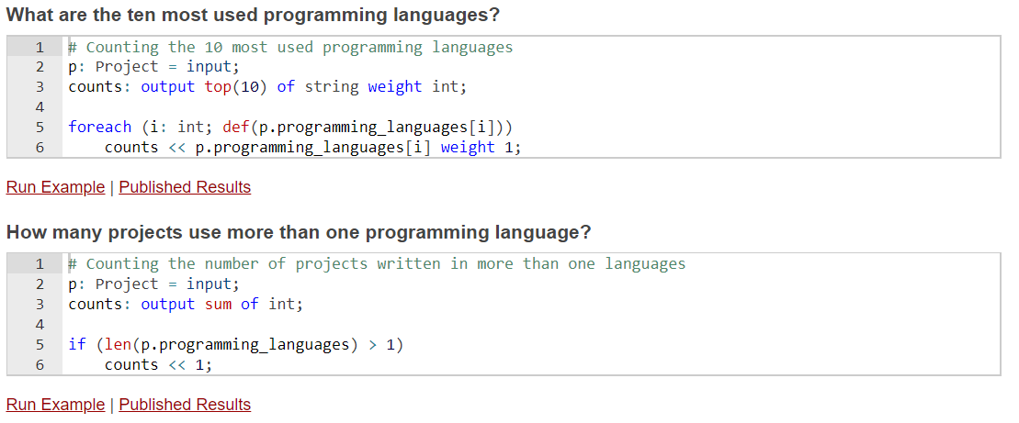
Query Creation
Boa queries are used to answer wide variety of GitLab repository mining questions.
Requirement:
Create suitable queries for repositories of COMS/SE309 projects.
Creative.
Evaluate code qualities.
Notes:
Boa is a flexible language, and it is capable of answering different kinds of software repository related mining questions through the boa queries. The image on the slide represent a couple of boa query examples and how do they work. Our requirement for the query creation is to come up with suitable queries for our client to help them monitor COMS/SE309 project repositories on GitLab. The queries should mainly focus on evaluating the projects’ code qualities, as well as looking into more creative mining questions.

Slide 6
Displaying Data
Need to analyze data after it’s gathered
R Language
Statistical computing and graphics
Linear & nonlinear modeling
R Environment
Primarily written in C, Fortran, and R
Free GNU package
Notes:
Once we are done querying the data, we’ll need a way to analyze it, since it can be hard to take away any useful information by just reading the data as is. This is where R steps into the picture.
R is a programming language used for statistical computing and graphics.It can display the data on graphs with linear/nonlinear modeling. And if needed, we can use some of its functions to gather other statistics. Additionally, it has a command line interface and several GUIs that the user can pick from based on their personal preference
The R environment is written primarily written in C, Fortran, and R, and can be downloaded for free as a gnu package. Because a lot of R’s std functions are also written in R, it makes understanding the algorithms a lot easier if you’re trying to go through and figure out how they work

