Slide 1
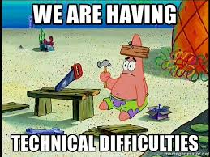
Lightning Talk:
Technical Difficulties
Team 43 SD-MAY-20:
Yi-Hsien Tan
Megan Miller
Adrian Hamil
Diego Realpe Tobar
Benjamin Carland
Notes:
Hello and welcome to senior design group 43’s last lightning talk regarding technical difficulties that appeared over the course of our project.Our Members $Members

Slide 2
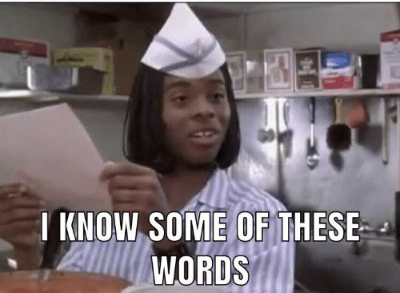
What has our biggest technical challenge been so far?
As Seniors we all had experience with data manipulation languages. E.g. SQL, MongoDB
Our client’s request to use BOA put us on unfamiliar ground
SQL and BOA can be wildly different in many areas
Have to identify tricky information. code errors, code languages
New syntax and keywords.
Boa Scripts are run differently
Understanding the backend for data generation from repositories
Notes:
What has been our biggest technical challenge so far? Our project delves deep into data gathering, manipulation and analysis, and many of us have had experience with these. However one of our client’s requirements was that the project be developed using a new domain specific language geared specifically over data analysis of programming code called BOA. It is wildly different from SQL and other tools we have used before and we found ourselves unsure about how to proceed. On the execution part It runs in a very different way compared to SQL and feeding information requires advanced processing of the data before queries can be made. Furthermore, on the syntax side its keywords and syntax are new and simpler as BOA’s goal is to be a more powerful and simple version to analyze large pieces of information.

Slide 3
Actions Taken!
More resources were needed
We contacted our advisor, Simanta Mitra with our concerns
He connected us to resources and experts to give us insight
The biggest one were the researchers from the ISU BOA Labs
We arranged two meetings to focus on two aspects of our project
Setting up the project’s backend pipeline
Learning about BOA syntax
Notes:
We took some actions to try and expand our knowledge but after looking at the information available online we quickly realized we needed more help. This brought us to contact our advisor Dr. Mitra and communicate some of the problems we were having. Even though Dr. Mitra did not have the answers right away, he helped us immensely by connecting our team with some of the researchers that have been working on BOA in the ISU Computer Science department. After we met with them, we decided to set up some meetings to have some of our questions asked in two major parts of our project. Setting up the backend pipeline and learning about the syntax.

Slide 4
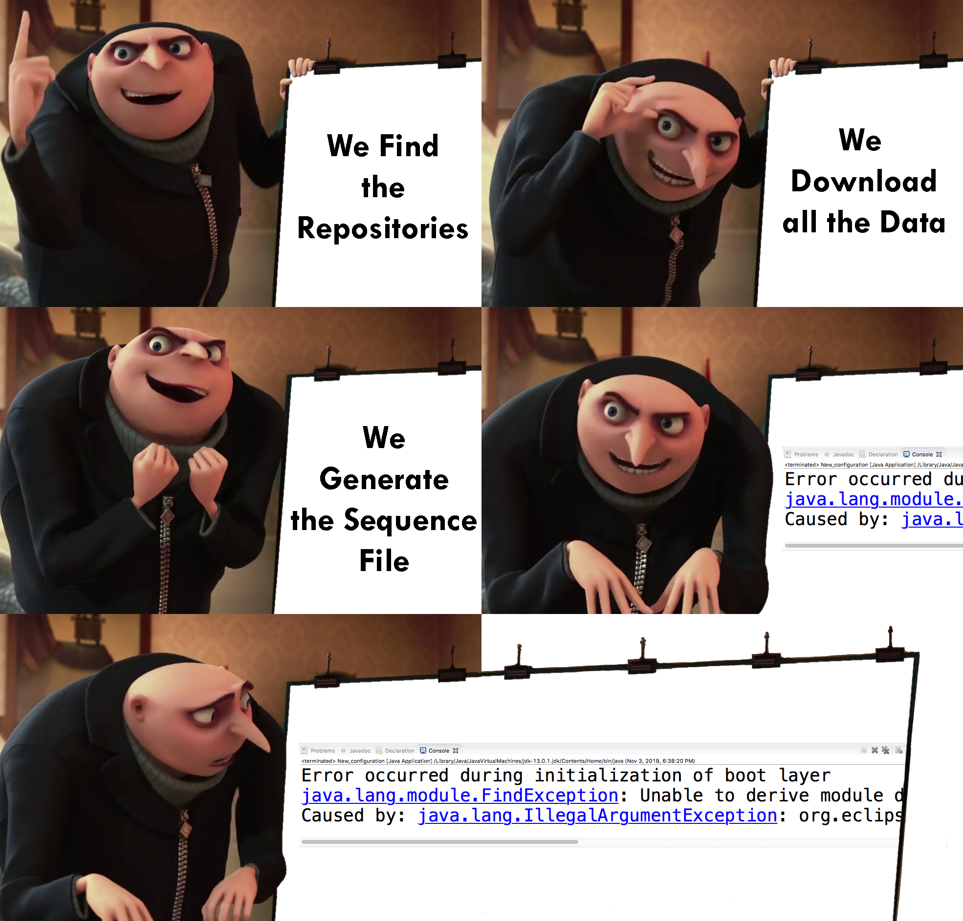
OTC - Data Retrieval Meeting
Things Revealed in the Meeting,
Actual structure of the backend pipeline
Creation process for Json metadata files
Potential steps for process automation
Technical Difficulties in Data Generation
Sourcing hardware
Installing necessary programs
Applying that to other repository services
Notes:
//*upvotes*

Slide 5
OTC - Understanding Boa language
Run practice scripts on Eclipse and the ISU website
Received recommendations from Sumon Biswas
Cannot run Boa locally
Can run scripts from command line
Read boa textbook
What we need to focus on
Understand AST (Abstract Syntax Trees)
Know the attributes of the ‘Project’ object
Understand queries
Notes:
On Wednesday, the Boa team from our group went to meet with one of the Graduate students who specializes in the Boa language, Sumon Biswas. We came to the meeting with 3 primary goals, to see if there were any new resources that Sumon could recommend for us to use, to ask some technical questions that we needed answering for project scope and to get some more groundwork information about how the language works. Sumon recommended that we use a Boa pdf resource for reference that we had yet to really use. For our technical questions we needed to know if Boa queries could be run entirely locally, the answer to this was unfortunately a hard No. The other question we needed to ask was can Boa queries be run through command line? The answer to this was technically yes but not in the way we wanted. The command line operation would only run the queries in the current eclipse plugin, which would make the whole process bulkier than what we had meant. Sumon also gave us a brief overview of how the language operates and the fundamental concepts that allow the language to operate and gave us a few pointers on things we should try to learn more about the language.

